Slide 1
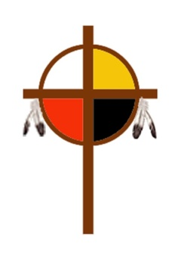
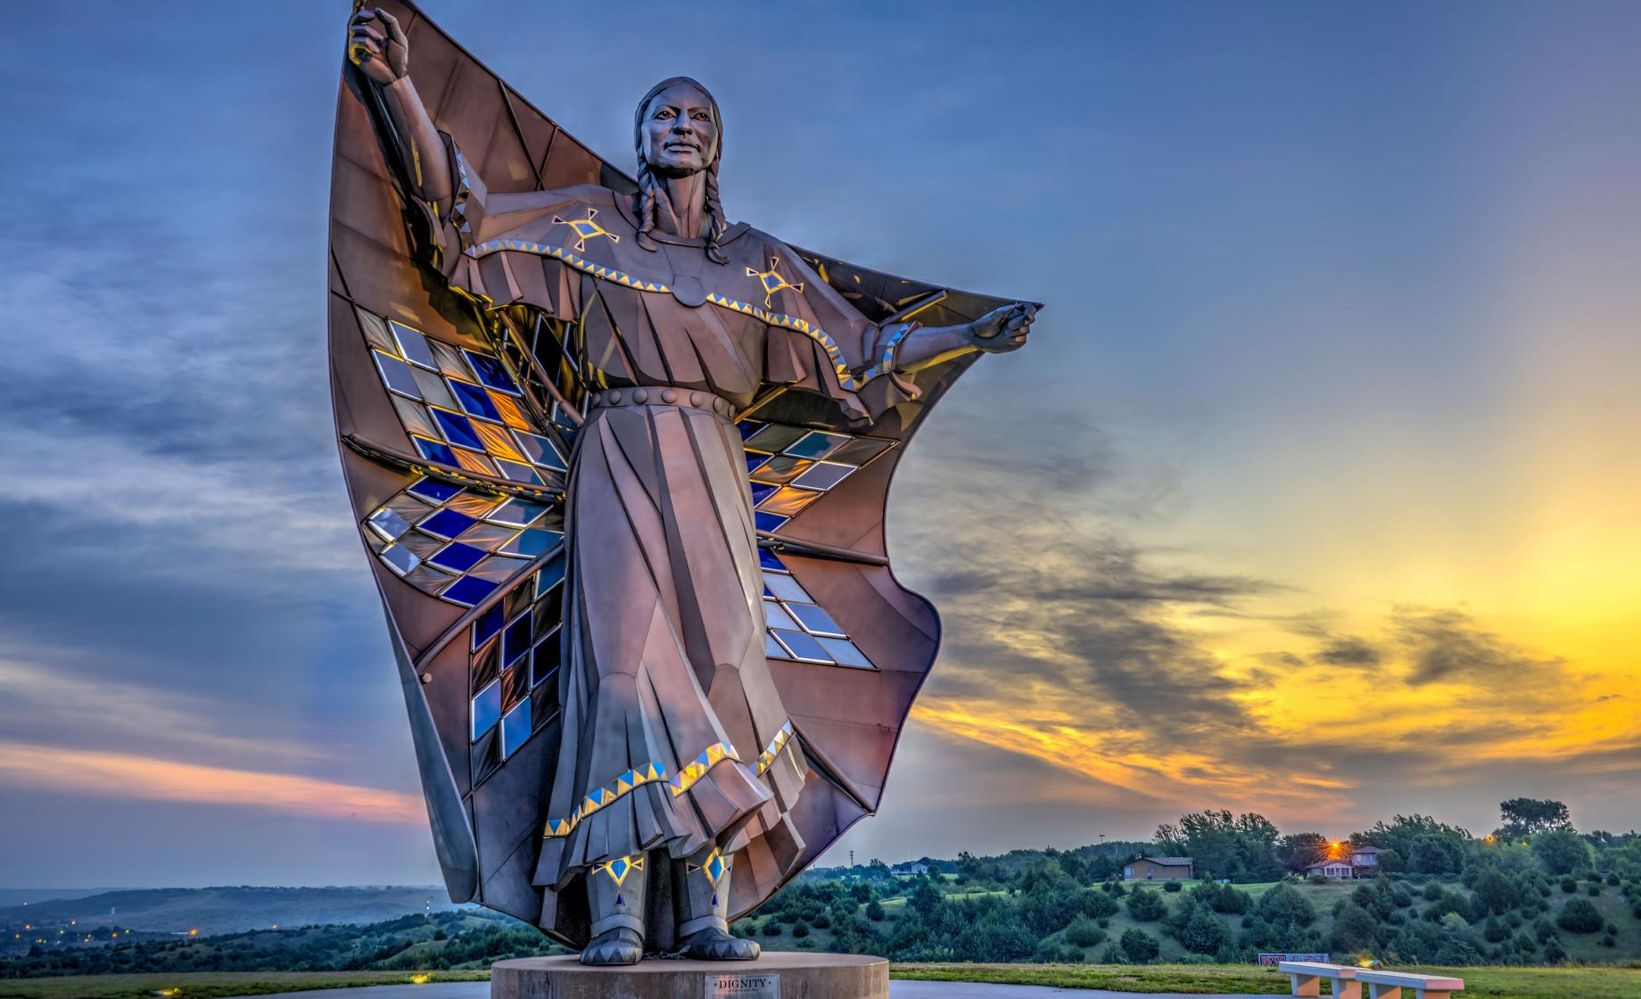
EPA CoNAM PRESENTS
HIDDEN FIGURES:
OUTSTANDING
NATIVE AMERICAN WOMEN
Notes:
You may be familiar with names like Pocahontas or Sacajawea and with stereotypical, often demeaning, images of Native Americans, but we want to tell you about outstanding women who have “moved mountains” or changed the lives of their people and all of us.
We will introduce you to women in an array of careers and professions in the fields of education, the arts, science, leadership and government, activism and religion.

Slide 2
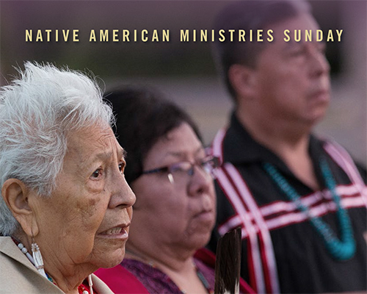
Opening Prayer
Holy Parent, Mother & Father of us all,
you inspire all creation with your Spirit.
We give thanks
for our days upon this earth,
for the delight you take
in the birds, animals, and fishes,
for the music of the stars,
and the subdued sounds
of the ocean depths.
With gratitude we take a moment of silence
for those who trod these lands before us.
Wherever our feet touch the earth,
we remember the ancestors
of the Indigenous Peoples
you created and placed in this land.
(Moment of silence)
Rev. Dr. Suzanne Wenonah Duchesne, permission to use by request.

Slide 3
Opening Prayer
We honor those you called good
and through whom you shared
your message of hospitality
for all the earth and her inhabitants.
We recognize Native American cultures
that honor and respect women,
and Native American women
living into their responsibility
for the land and the people.
Rev. Dr. Suzanne Wenonah Duchesne, permission to use by request.

Slide 4
Opening Prayer
Today we especially honor
Native American women,
who heard a call
to lead grace-fully,
to love fiercely,
to persevere powerfully,
in all of their beauty;
bringing their unique perspectives
borne out of their distinctive cultures
and experiences,
so that justice might prevail,
beauty could flourish,
and hope would blossom.
Rev. Dr. Suzanne Wenonah Duchesne, permission to use by request.

Slide 5
Opening Prayer
Though they may be hidden
from the minds of many
who bask in worldly power,
and remain invisible to those
who enjoy the privileges
of principalities;
they are not hidden from you.
Rev. Dr. Suzanne Wenonah Duchesne, permission to use by request.

Slide 6
Opening Prayer
Let us remember that they are sacred
as all women are sacred to you,
and they are precious to you,
as all creation is precious,
so that we might not only
honor them with our words,
but consecrate their stories
with our actions,
blessing the Elders
and encouraging the next generation;
in the name of the One who
creates us,
redeems us,
and empowers us.
Amen.
Rev. Dr. Suzanne Wenonah Duchesne, permission to use by request.

Slide 7
EPA CoNAM PRESENTS
HIDDEN FIGURES:
OUTSTANDING
NATIVE AMERICAN WOMEN
Researched & Written by Verna Colliver, Sherry Wack, and Sandi Cianciulli, permission to use by request.
Notes:
You may be familiar with names like Pocahontas or Sacajawea and with stereotypical, often demeaning, images of Native Americans, but we want to tell you about outstanding women who have “moved mountains” or changed the lives of their people and all of us.
We will introduce you to women in an array of careers and professions in the fields of education, the arts, science, leadership and government, activism and religion.

Slide 8
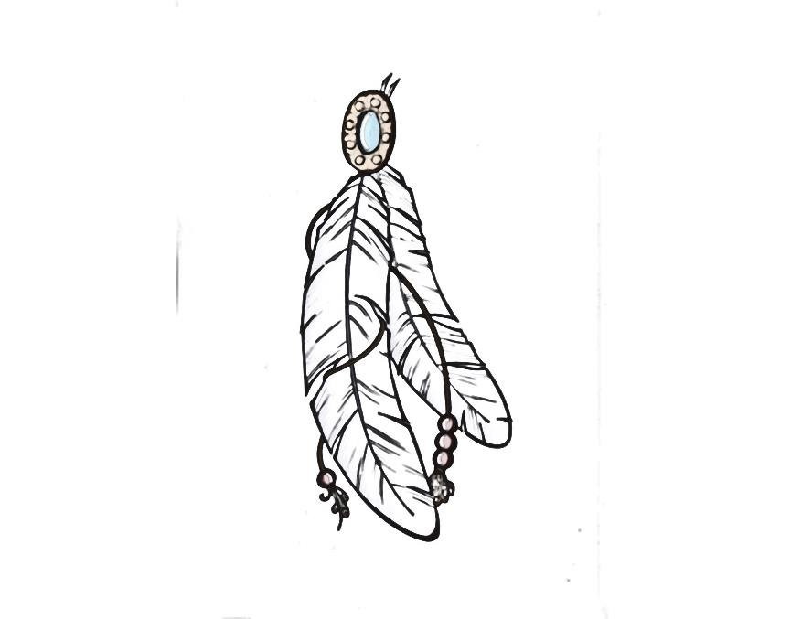
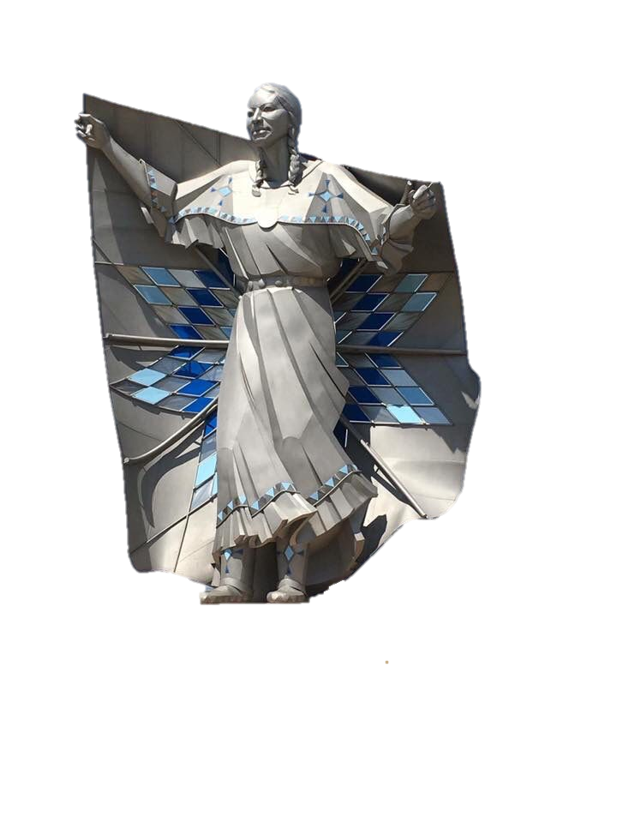
Outstanding women activists and advocates fighting for justice and fairness
Notes:
Meet Gertrude Simmons, Ladonna Harris, Eliza “Lyda” Conley, Lucy Covington, Elizabeth Peratrovich, and Elouise Cobell.

Slide 9
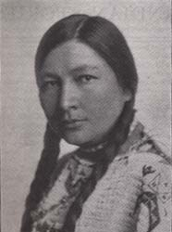
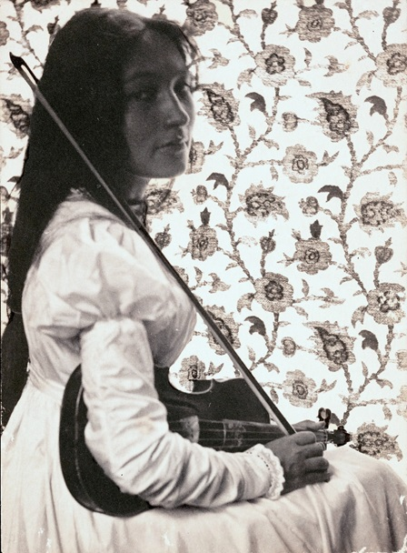
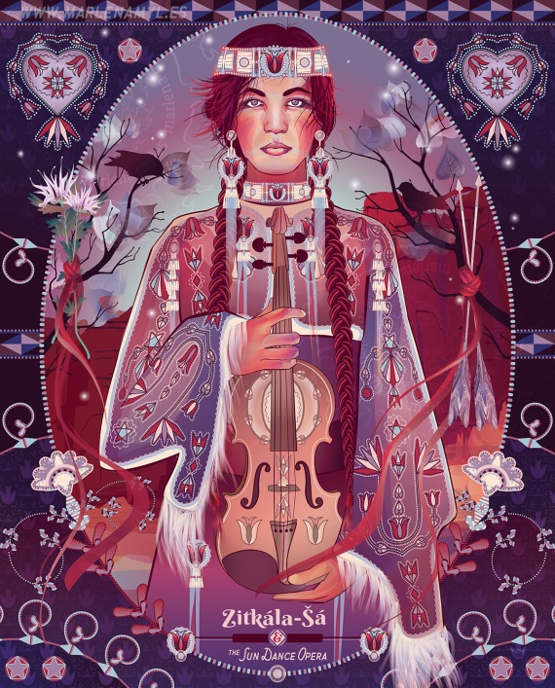
Gertrude Simmons Bonnin
Yankton Sioux (1876-1938)
Traditional name: Zitkala Sa = “Red Bird”
First Native American to write an opera
Concert Violinist
Her writings strongly criticized forced assimilation
Secretary of the Society of American Indians
and editor of the American Indian Magazine
Founded the National Council of American Indians
Notes:
Gertrude was an educated Native American woman who struggled and triumphed in a time when severe prejudice prevailed toward Native American culture and women. She was taken from the reservation to attend White's Manual Labor Institute in Wabash, Indiana, a school funded by the Quakers. She later enrolled in the Santee Normal Training School closer to home. In 1895, she accepted entrance and scholarships to Earlham College in Indiana.
Although writing was her real love, she was an accomplished violinist and won a scholarship to the Boston Conservatory of Music. In 1913 she collaborated with classical music composer William Hanson to write an opera, “Sun Dance.” Never before or since has an opera been written by a Native American.
Her strongest impulse was to fight for the rights of her people through literature and politics.

Slide 10
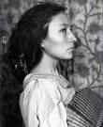
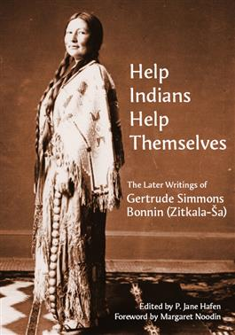
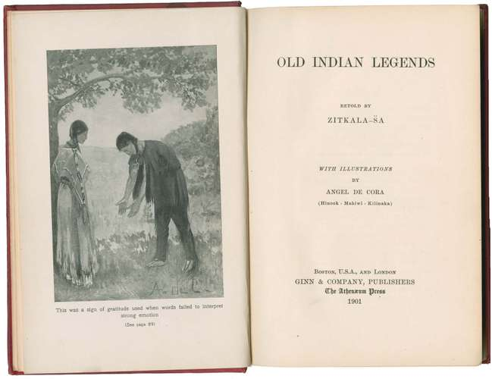
"Zitkala-Sa of the Sioux Nation"
Notes:
Gertrude accepted a teaching position at the Carlisle Indian School founded by Richard Henry Pratt whose philosophy was “kill the savage; save the man.” She fiercely objected to the idea that everything Indian was “evil,” leaving the school after two years.
As a writer, she adopted the pen name "Zitkala Sha" and in 1900 began publishing articles criticizing the Carlisle Indian School. She resented the degradation students underwent, from forced Christianity to severe punishment for speaking in native languages. She was criticized for not showing gratitude for the kindness and support that white people had given her in her education.
A strong political voice for Native Americans, Gertrude wrote Oklahoma's Poor Rich Indians: An Orgy of Graft, Exploitation of the Five Civilized Tribes, Legalized Robbery. This work, published in 1924, with two white co-authors, exposed the robberies and murders in Oklahoma of Native American people and led to the Indian Reorganization Act of 1934, reestablishing a trust for Indian lands.
She was also pivotal in gaining the rights of citizenship and the vote for Native Americans. She did this by seeking unity between all tribes in a pan-Indian political power. Thus began the National Council of American Indians, in 1926. After the death of Gertrude and her husband, the organization ended and in 1944 the National Congress of American Indians was formed and is a powerful voice for Native Americans today.
When Gertrude died in 1938 she was buried in Arlington National Cemetery with a tombstone marked "Zitkala-Sa of the Sioux Nation," and inscribed with a picture of a tipi. Ironically, the burial honor was due not to her great contributions to the U.S., but because of her husband's position as an Army Captain.

Slide 11
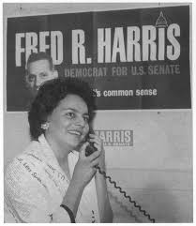
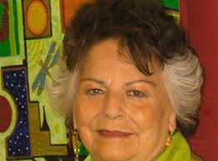
LaDonna Harris
Comanche (1931- )
Supported her spouse in helping American Indian people allowing them to find their political power
Founded Oklahomans for Indian Opportunity (OIO)
Taught the U. S. Congress “Indian 101” to dispel stereotypes and cultural misunderstandings
Created American Indian Ambassadors to help Indian youth integrate tribal values with their work and travel
“Grand Dame” of the National Congress of American Indians
Notes:
LaDonna Harris grew up in Oklahoma during the Great Depression, a time of great hardship for most Americans and more so for American Indians. The government’s General Allotment Act and urban relocation programs was a traumatic time of transition and loss of homelands.
Raised by her grandparents, Ladonna felt it was “the most wonderful thing” for her because they were “steeped in their Comanche culture and values,” a very rich environment for her childhood.
She met Fred Harris in high school and during the next three decades of their marriage she worked with him in his political career. When Fred won a seat in the Oklahoma State Senate and later in the U.S. Senate, she took an active role in his service, learning skills that came in handy for Fred’s Presidential campaigns in 1972 and 1976 and her own run for Vice President in 1980.

Slide 12
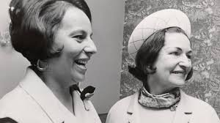
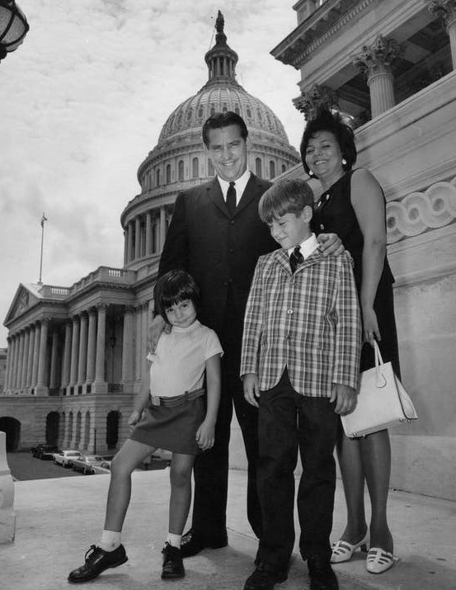
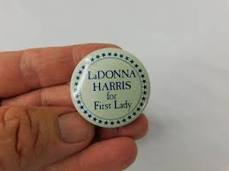
“More than a Senator’s wife”
Notes:
LaDonna was more than a Senator’s wife, becoming famous for meetings in her living room, where the group called Oklahomans for Indian Opportunity (OIO) was born. The group met first in LaDonna's home and soon travelled to other towns until they had united the five tribes and the plains people, all of whom had previously been dislocated. OIO was the first statewide Indian organization in Oklahoma.
OIO took on such issues as discrimination in public schools and the alarmingly high dropout rate for Indian high school students. Other issues included the support of Indians in urban environments (having been relocated there through government programs), health and community services where urban Indians live, and outreach programs to address the increasing incidence of suicide among American Indians. She also testified before Congress to ensure that OIO received funding for these programs.
She served on many committees and advisory boards with members of Congress, teaching them what she would refer to as "Indian 101,” educating them on issues of importance to Indians in America, and on the nuances between the different tribes.
LaDonna created the American Indian Ambassadors program giving two-year fellowships to instruct youth in tribal values and modes of government, and support their travel to other countries to observe indigenous governments first-hand and forge international friendships and connections. She believed that Indian youth both benefit and contribute the most when they are able to fold their traditional values into their contemporary society.
She has passed on the role of leadership in her programs to her daughter and is teaching her grand-daughter the Comanche language.

Slide 13
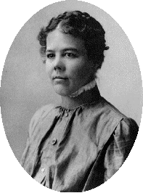
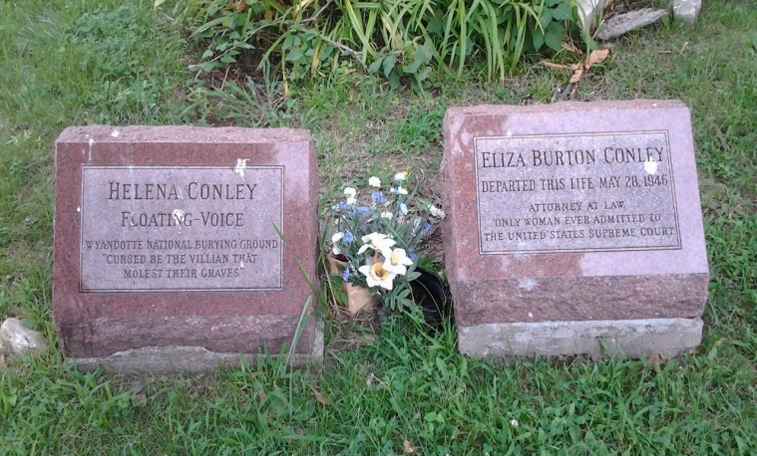
Eliza Burton ‘‘Lyda’’ Conley
Wyandot Nation (1869-1946)
Rowed a boat daily across the Missouri River to attend Park College
First woman admitted to the Kansas bar
Taught Sunday school classes in the Kansas City
Methodist Episcopal Church
First Native American woman to argue a case before the U.S Supreme Court
Led the effort to preserve the Huron Indian
Cemetery
Notes:
Eliza Conley was born in 1869, a member of the Wyandott Nation years after her people lost their homeland and were pushed west, finally to Kansas. Her family strongly encouraged her and her sisters to pursue an education, and she and her sister rowed a boat daily across the river to pursue her education. She graduated from Kansas City School of Law in 1902 and became the first woman admitted to the Kansas Bar.
Eliza may have been inspired to pursue a career by her independent and unconventional great great-aunt Elizabeth “Betsy” Zane who was immortalized by the western writer Zane Grey.
After finding a home in Kansas, the Wyandots were faced with a choice by a government Treaty in 1855: Become a U. S. citizen or be deemed “incompetent.” Both her grandmother and mother refused to make a choice, wishing to remain members of the Wyandot Nation. Although the Indian agent ignored their choice, the mother and her daughters regarded themselves as Wyandot rather than U. S. citizens.
Through marriage and adoption, the Wyandots assimilated into their tribe members of other Indian nations, a great many whites, and some African Americans. Through the ministry of John Stewart, an itinerant Methodist Episcopal missionary of mixed African-American and Indian
Heritage, among the Wyandots in Ohio, many of them practiced Christianity according to the dictates and traditions of the Methodist Episcopal Church. Despite that assimilation, they maintained their historic cultural traditions and political practices, and most still spoke their native language, Wendat.
The Indian Removal Act of 1830 forced them from their land in Ohio and Michigan and eventually they found a home in Kansas. But the removal took a great toll from diseases brought on by exposure, flooding and epidemics that spread through the western frontier. The dead were buried on top of a bluff above the Missouri River and that burial ground came to be known as the Huron Place Cemetery. Some 60 years later it would become the focal point of Eliza’s case brought before the U. S. Supreme Court.

Slide 14
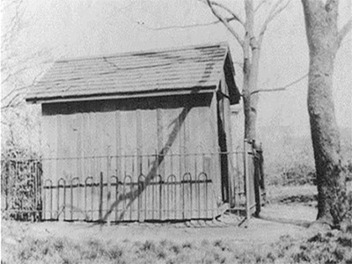
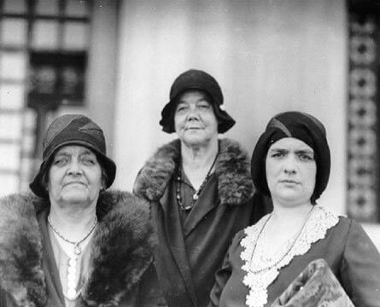
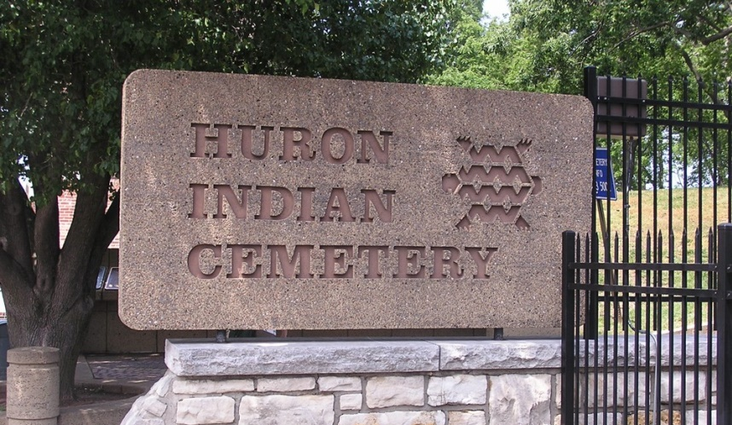
“Trespass at Your Peril!”
A heroic fight to protect the graves of their ancestors.
Three sisters will not give up their case. They keep vigil to protect the cemetery in a small shed, named Fort Conley.
Notes:
As Kansas City grew, extensive property development occurred around the Huron Indian Cemetery, and it became a commercially valued property. Tribal council members’ attempts to sell the land and have the graves removed aroused great resistance. Later, legislation authorizing the sale of the property was the last straw for Eliza Conley.
So she and sisters launched a campaign to protect and preserve the Huron Cemetery in Kansas City. Conley petitioned the U.S. District Court for the District of Kansas to stop the sale. When that failed, she bravely appealed to the U.S. Supreme Court, becoming the first female Native American lawyer to be admitted before the court only to fail again.
The trio took up camp just outside the cemetery, nicknamed “Fort Conley.” They padlocked the gate, took turns standing guard with muskets drawn, and put up signs that read “Trespass at Your Peril.” They kept up the fight, faced arrests and even a brief jail term for Eliza.
Although she died before accomplishing her goal, efforts continued to preserve and protect the burial ground. In support of their cause, Senator Charles Curtis, also of Native American ancestry, introduced a bill to Congress to make the land a national park, and the law was passed in 1916, preventing future development of the cemetery land.
Eliza died in 1946 before achieving a complete victory, but her rationale for the honoring the burial ground as sacred space eventually led to the provisions of the federal Native American Graves Protection and Repatriation Act. In September 1971, the cemetery was placed on the National Register of Historic Sites. It was designated a national historic landmark in 2017, over 100 years after Eliza “Lyda” Conley argued her case in Washington.
The Huron Indian Cemetery stands as a testament to history, heritage, and the difference one person can make.

Slide 15
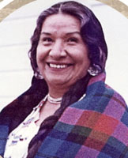

Lucy Friedlander Covington
Colville Federated Tribes (1910-1982)
Has Jewish family heritage
Graduated from Haskell Institute in Kansas
Cook for Civilian Conservation Corps
Chair of Colville Tribal Business Council
Fought against termination
Notes:
Lucy Friedlander Covington, born on the Colville Indian Reservation in Washington State, was descended from five of those bands as well as from a German Jewish merchant. Mary Moses, wife of Chief Moses and Lucy’s great grandmother, became her caretaker and teacher, giving Lucy a foundation in her heritage and history, and importantly, the reason why the land and traditions were so important for their people.
After graduating from the Haskell Institute in Kansas, Lucy returned to Washington and in 1933, during the Great Depression, went to work as a cook in a Civilian Conservation Corps Indian Division forestry camp on the Colville Reservation. There she met her husband John Covington and they married in 1936.
George Friedlander, Lucy’s brother, realized the need to fight the termination bill introduced in Congress in 1953 but because of ill health he had to step down from his role in the Tribal Council. Lucy ran for George's council seat for the Nespelem district and was elected in 1954, a victory that initiated one of the most significant chapters of her life and of Colville tribal history.

Slide 16
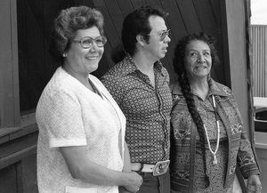
Lucy Leads the Fight
"Termination is something no Indian should ever dream about ... It's giving up all your Indian heritage ... It's giving your eagle feather away"
Colville Confederated Tribes members Shirley Palmer
and Mel Tonasket with Lucy Covington.
The Jewish American Society for Historic Preservation, honors her legacy of fighting for her land.
Notes:
Lucy Covington persisted in her fight, traveling repeatedly to Washington, D.C. Lobbying Congressional leaders why the Termination policy was an injustice to Native Americans. She took her protégé Mel Tonasket with her to learn how to continue the struggle after she would no longer be there. Her efforts attracted broader and broader support from the Native American communities though she initially had to persuade her fellow Tribal Council Members it was in their best interests. Her fight brought protection for the rights and heritage of all Native Americans. In 1970 President Richard Nixon ended Termination.
She is honored and respected by the Jewish community for seeing the land as sacred and holy. A member of the Jewish American Society for Historic Preservation spoke at the unveiling of a historic marker where Eastern Washington University had returned land to the Colville Tribe to be restored to its natural state.
Through an ongoing partnership with the Colville Confederated Tribes, Eastern Washington University continues to honor the legacy of Lucy Covington. Within the Lucy Covington Initiative, four emphasis areas have been identified: supporting future leaders; creating a confluence of culture and causes; development of a Lucy Covington archives; and finally a Lucy Covington Center.

Slide 17
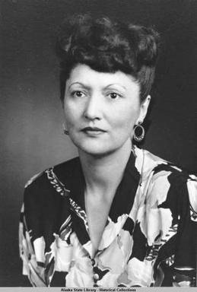
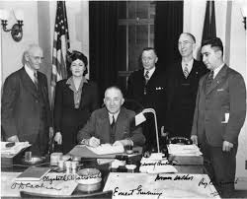
Elizabeth Peratrovich
Tlingit (1911-1958)
Responsible for the first anti-discrimination law in the U.S.
Served on the federal Bureau of Indian Affairs
Alaskans celebrate Elizabeth Peratrovich Day annually February 16
Featured in The Book of Gutsy Women by Hillary and Chelsea Clinton
Commemorated on the Native American $1 coin in 2020
Notes:
Elizabeth Peratrovich was born before Alaska bacame a state and was left in the care of the Salvation Army and then adopted by Andrew Wanamaker, a Presbyterian minister, and his wife, Jean. Wanamaker was a charter member of the Alaska Native Brotherhood, a nonprofit organization formed to address racism.
She grew up speaking both Tlingit and English and when her family moved to a Native village on Prince of Wales Island, she met her future husband. They both graduated from the public high school in Ketchikan, an integrated school after a successful suit by a Tlingit leader.
She became a civil rights activist in Alaska, was credited with advocacy that gained the passage of the 1945 Alaska territory Anti-Discrimination Act. The Act was the first anti-discrimination law in the United States, signed well before the federal Civil Rights Act was passed in 1964 and 14 years before Alaska became the 49th state.
On February 6, 1988, the Alaska State Legislature established February 16 (the day of the 1945 signing of the Anti-Discrimination Act) as “Elizabeth Peratrovich Day,” to honor her contributions “for her courageous, unceasing efforts to eliminate discrimination and bring about equal rights in Alaska.” In 1992, Gallery B of the Alaska House of Representatives chamber in the Alaska State Capitol was renamed in her honor.
In 2018, Elizabeth was chosen by the National Women’s History Project as one of its honorees for Women’s History Month in the United States.

Slide 18
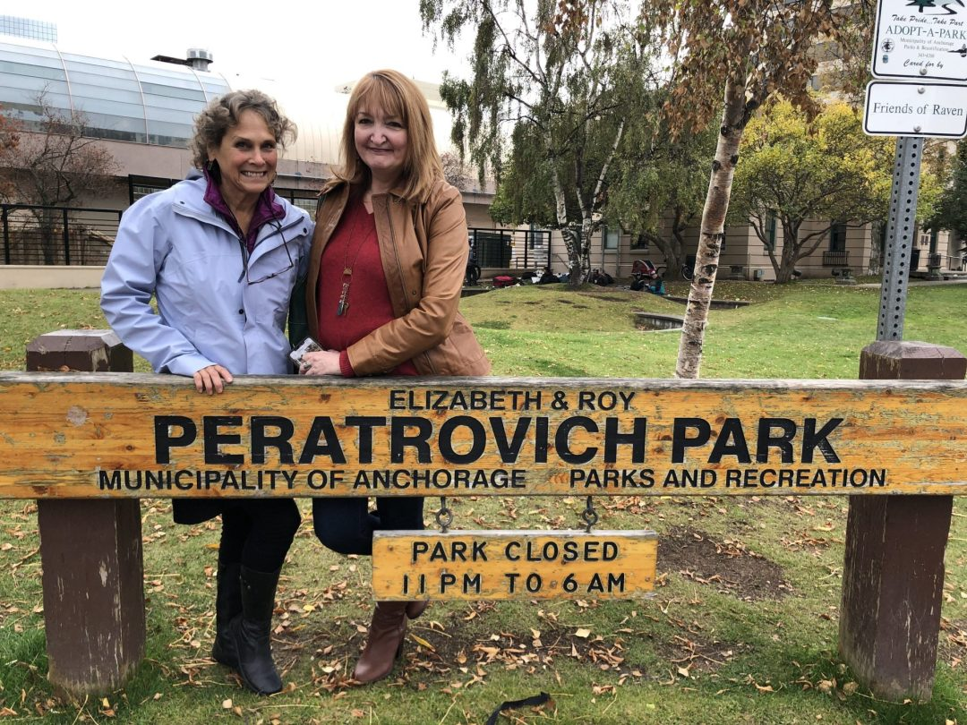
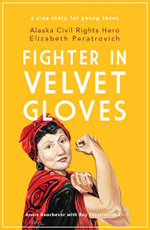
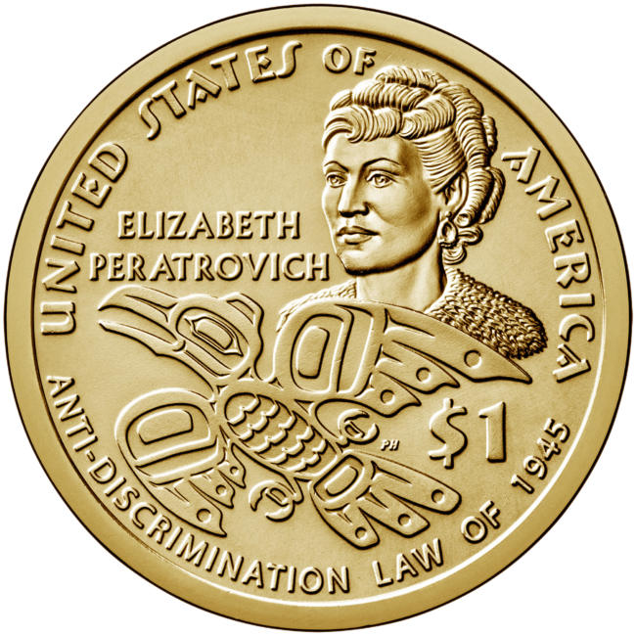
“Fighter in Velvet Gloves”
Notes:
Elizabeth Peratrovich is a celebrated hero in Alaska for her fight to end discrimination. She and her husband began the fight after seeing a sign, “NO NATIVES ALLOWED” on a hotel door and did not give up until 1945 when the Anti-Discrimination Act was passed, 11-5.
In the Senate after heated debate, the floor was open for public comments. Having heard Senator Allen Shattuck’s claim that “these people barely out of savagery” would not want to “associate with us whites with 5,000 years of recorded civilizations behind us,” Elizabeth rose from her seat in the back where she had been knitting while following the debate. “I would not have expected that I, who am barely out of savagery, would have to remind the gentlemen with 5,000 years of recorded civilization behind them, of our Bill of Rights.” A newspaper reported that her testimony shamed the opposition into a “defensive whisper.” The gallery broke out into a “wild burst of applause.”
In 2020, the United States Mint commemorated Peratrovich on a $1 coin. A bronze bust sculpted by her son Roy Jr. adorns the lobby of the State Capitol.
In the Book of Gutsy Women, Chelsea Clinton writes a tribute to Elizabeth and ends by pointing out that the work she began continues, most recently as 2014 when litigation was required to force Alaska to provide voting information in the tribal languages. Her son, Roy Peratrovich, Jr., has written a book for young readers with Annie Boochever titled appropriately, Fighter in Velvet Gloves: Alaska Civil Rights Hero Elizabeth Peratrovich. Chelsea ends by saying: “I can’t wait to read it with our kids when they’re a little older.

Slide 19
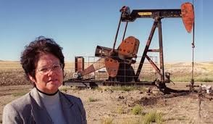
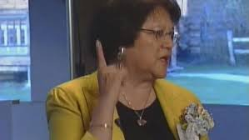
Elouise Pepion Cobell
Blackfeet Nation (1945-2011)
“Yellow Bird Woman”
Treasurer for the Blackfeet Nation
Led the largest class action lawsuit against the Federal government.
Awarded a “genius grant” from the MacArthur Foundation in 1997
Inspired an award-winning documentary, “100 Years, One Woman’s Fight for Justice”
Posthumously awarded the Presidential Medal of Freedom
She was absolutely Elvis Presley’s #1 fan!
Notes:
Born one of nine children on the Blackfeet Reservation on Nov. 5, 1945, Elouise Pepion was the great, great granddaughter of the revered Mountain Chief, the hereditary chief of the Blackfeet who refused to compromise with the U.S. government. “I like to think a little bit of him trickled down to me,” Cobell said. She knew the desperate situation of her people who suffered through harsh winters and were not allowed to hunt or carry arms on the reservation by Indian agents who wanted to control them.
Cobell became treasurer of the Blackfeet Nation in 1976, and in 1987 she helped to found the Blackfeet National Bank (now Native American Bank), the first American bank owned by a Native American tribe. She was awarded a “genius grant” from the MacArthur Foundation in 1997 and used most of the $300,000 prize to fund the class-action suit. The legal battle, Cobell v. Salazar, which spanned 14 years, 10 appeals, and 3,600 court filings, finally ended in late 2010 when Congress passed legislation that was subsequently signed by U.S. Pres. Barack Obama. A federal judge gave final approval to the measure on June 20, 2011.
Buy-back of lands has continued, restoring acreage to the tribes. As of November 2016, $40 million had been contributed to the scholarship fund by the government, from its purchase of lands. It has paid $900 million to buy back the equivalent of 1.7 million acres in fractionated land interests, restoring the land base of reservations to tribal control.

Slide 20
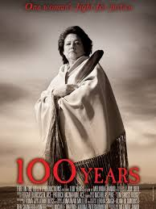
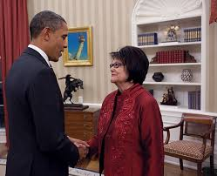
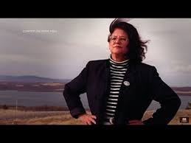
"If someone tells me something can't be done, I get so mad I just have to do it." Elouise Cobell
Notes:
The documentary, “100 Years: One Woman’s Fight for Justice” tells the moving story of Elouise Cobell’s refusal to give up even when facing unimaginable hurdles.
President Barack Obama had kept his campaign promise to bring a fair and just resolution to the Cobell lawsuit. “After years of delay,” he said, “this bill will provide a small measure of justice to Native Americans whose funds were held in trust by a government charged with looking out for them.”
The woman who fought so long and hard for justice, however, never saw those checks. On October 16, 2011, just four months after the Court’s final approval of the settlement that bore her name, Elouise Pepion Cobell succumbed to a deadlier battle, cancer.
In November 2016 Cobell's work on behalf of Native Americans was honored by the award of a posthumous Presidential Medal of Freedom by President Obama; her son Turk Cobell accepted the award on her behalf.

Slide 21
Outstanding women in education, broadcasting, and publishing
Notes:
Meet Sarah Winnemucca Hopkins, Annie Waneuka, Esther Martinez and Angel DeCora.

Slide 22
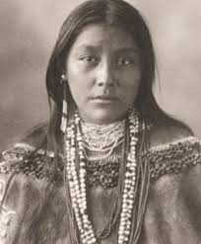
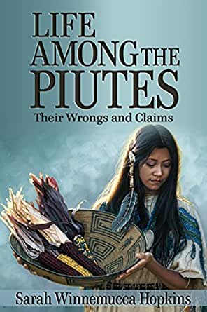
Sarah Winnemucca Hopkins
Northern Paiute (c. 1844-1891)
Traditional name: Thocmetony “shell flower”
Her autobiography is the first narrative by a
Native American woman
Fighter for the rights of her people
Teacher in a school for Paiute children
Front page story in the NY Times praises her
courage as a government messenger, scout and
interpreter
Notes:
Born in 1844, Sarah Hopkins moved between two cultures, writing her autobiography, Life Among the Paiutes, in English. As suggested by the subtitle, “Their Wrongs and Claims,” she voices her critique of Anglo-American culture while noting the fraught legacy of federal lands. Realizing the new reality, she worked tirelessly to educate Paiute children, teaching them to read and write in English and training them in marketable skill. She fought against government attempts to take over their land and in desperate times in the winter she pleaded for help from the military, assisting them as a scout and interpreter during the Bannock War. She was criticized because whites thought she was too native and Native Americans thought she was too white.

Slide 23
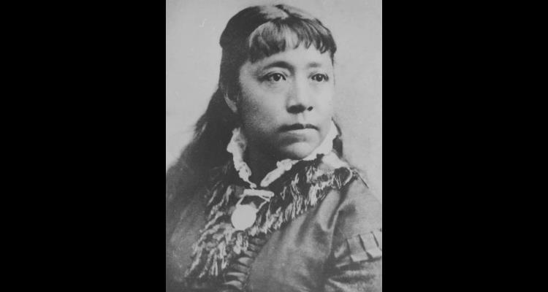
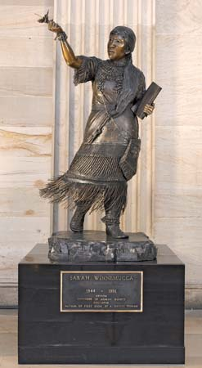
She took her fight to Washington
D. C., meeting the President and
Interior Secretary
Her statue stands in the National
Statuary Hall Collection in the
U. S. Capitol
Notes:
She was a spokeswoman for the Pauite band that inhabited land around Pyramid Lake, traveling to Washington D. C. to plead her case, meeting with President Rutherford B. Hayes and Interior Secretary, Carl Shurz.
One of Sarah’s most outspoken critics was Senator McCarran, who thought the American Indian was the loser to the pioneers who were fulfilling their “Manifest Destiny.” Though the popular Senator introduced a bill each legislative session to give the disputed land to the squatters for a small fee, his bills went nowhere. His popularity as a legislator earned him one of the two statues in the National Statuary Hall allotted to the state of Nevada in 1960. In a “delicious irony” the other statue was erected in 2005 to honor Sarah Winnemucca, the Native American woman he demeaned and ridiculed. The sculptor depicts her with her right hand holding aloft a shell flower and the fringe of her skirt blown by the wind suggesting her persistent push forward to help her people.

Slide 24
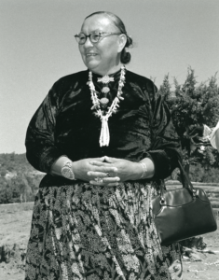
Annie Dodge Wauneka
Navajo (1910-1997)
“Legendary Mother of the Navajo”
Survived the 1918 influenza epidemic
Wrote a dictionary of medical terms in Navajo
Active in Head Start and Girl Scouts
Served on Advisory boards of the U. S. Surgeon General and Public Health Service
Hosted a daily radio show
Notes:
Annie was in a government school on the reservation when the 1918 Influenza Epidemic struck. Although thousands died, she survived a mild case and was resistant to the disease, enabling her to care for those too ill to feed themselves. It helped to shape her life, leading her to work on public health issues. After studying public health, she sought election to tribal leadership and won, giving her a platform for her crusade in the fight against diseases and getting better health care for her people.
Her dictionary of medical terms in the Navajo language helped dispel the fears of “white man’s medicine.” She helped people get medical attention after years of relying solely on traditional healing. Helping to fight tuberculosis among the Navajo beginning in the 1950s brought her national recognition. Her daily radio show on KGAK in Gallup, New Mexico aired items of general interest along with important health information. Her belief in education is reflected in her commitment to Head Start and also Girl Scouts.

Slide 25
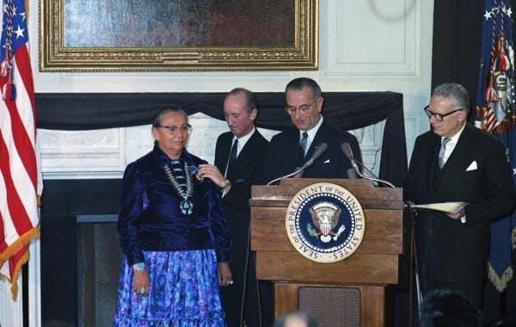
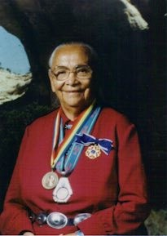
First Native American to receive the Presidential Medal of Freedom
Inducted in the National Women’s Hall of Fame in October 7, 2000
Notes:
Honoring Annie with the Presidential medal of Freedom in 1964, President Lyndon Johnson read the citation : “First woman elected to the Navajo Tribal Council; by her long crusade for improved health programs, she has helped dramatically to lessen the menace of disease among her people and to improve their way of life.”
Other honors followed: Ladies’ Home Journal selected her a Woman of the Year in 1976. In 1984, the Navajo Council designated her “The Legendary Mother of the Navajo Nation.” And in 2000, Annie was inducted in the National Women’s Hall of Fame, recognizing that through her efforts in education and health, the lives of every Navajo, as well as the nation at large, have been improved.

Slide 26
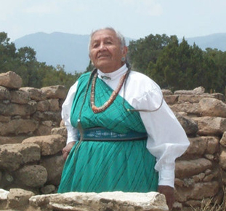
Esther Martinez
Tewa (1912-2006)
P’oe Tsawa – “Blue Water”
Graduated from a government boarding school
Published a children’s book
Worked to preserve the Tewa Language
Honored by NEA as a National Heritage Fellow
Notes:
Esther was sent to a government boarding school where she received harsh punishment for speaking her Tewa language. After graduation in 1930 she raised ten children and later worked at a middle school in San Juan Pueblo where she was asked to help document the Tewa language. She worked on the first Tewa Language Dictionary for use in village schools and translated the New Testament in the Tewa language.
A revered storyteller, she wrote a children’s book, "The Naughty Little Rabbit and Old Man Coyote,” and later published "My Life in San Juan Pueblo: Stories of Esther Martinez," recalling the stories of her youth. For her, stories were important, teaching tips for survival and for socialization in the community. For her, “Our whole life is storytelling.”
The National Endowment for the Arts in Washington, D.C. honored Mrs. Martinez as a 2006 National Heritage Fellow for folk and traditional artists.

Slide 27
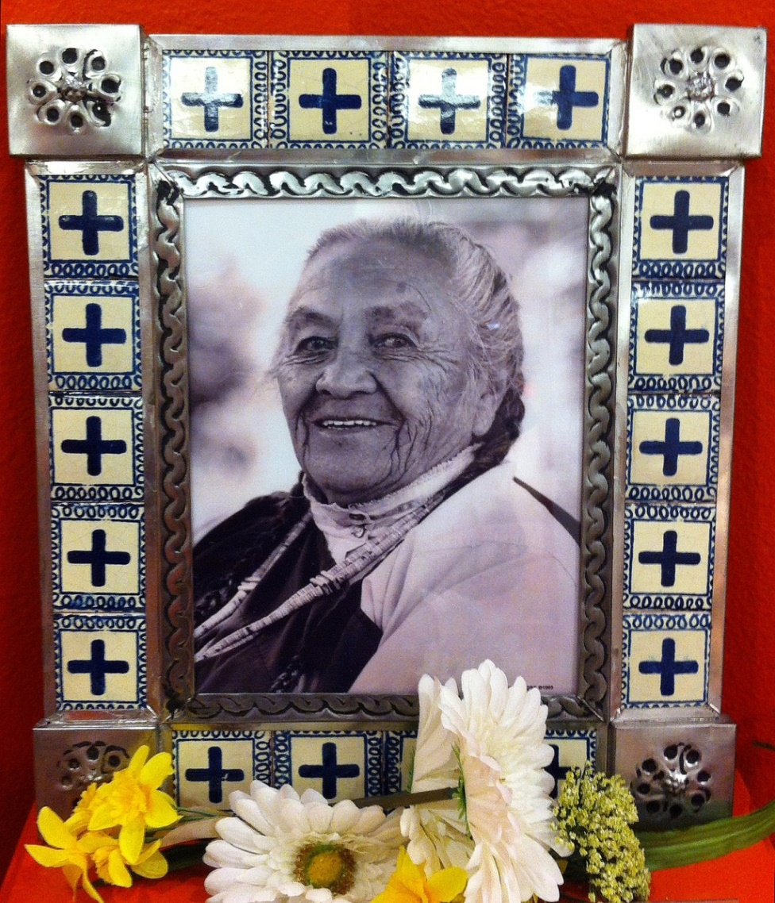
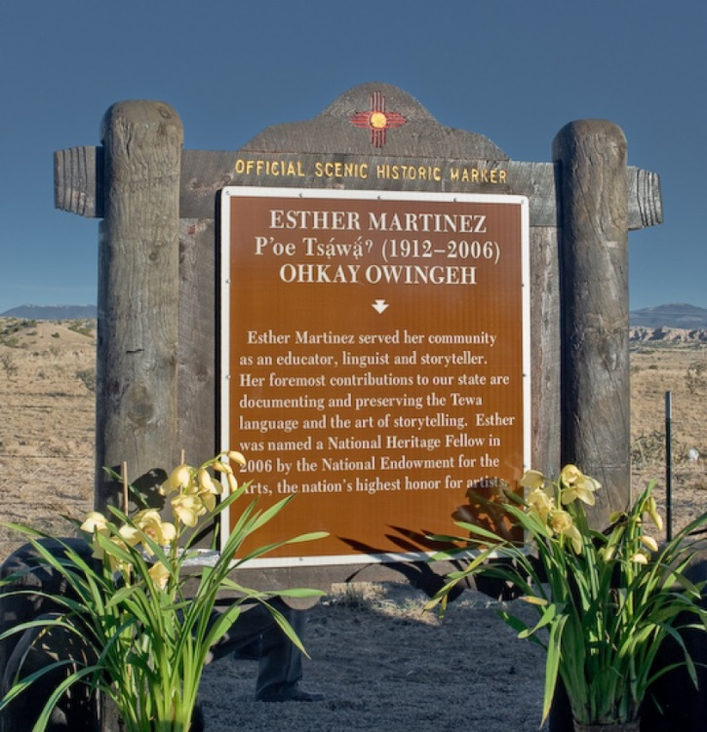
Esther Martinez Native American Languages Preservation Act
Became law in 2006
Reauthorization Act passed by Congress in December 2019
Notes:
The Esther Martinez Native American Languages Preservation Act was signed into law in 2006 providing funding to ensure the survival of Native languages and provide for programs of language immersion considered to be the best model for creating fluent speakers and successful Native leaders. The Act would create grants to empower communities to establish immersion programs to revitalize Native languages and improve Native economies.
An official scenic historic marker in New Mexico sums up her life’s achievements as an educator, linguist and storyteller.

Slide 28
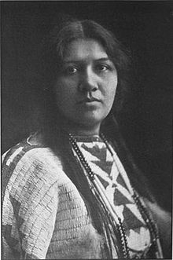
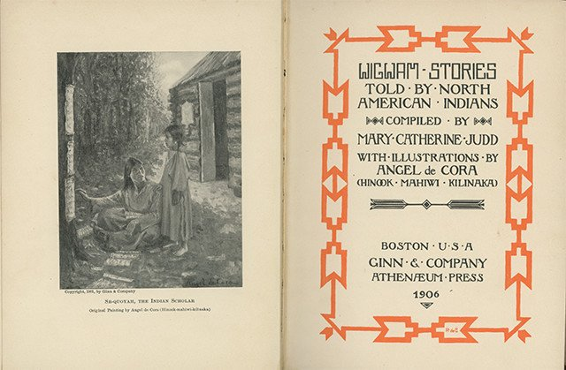
Angel DeCora
Winnebago (1871-1919)
Traditional name: Hinook-Mahiwi-Kilinaka – “Fleecy Cloud Floating in Place” or “Woman Coming on the Clouds in Glory” i. e. “Angel”
Sent to Hampton Institute, a government boarding school
Studied art at Smith College and Drexel Institute of Art, Science and Industry
Worked as a commercial artist
Taught art at Carlisle Indian School
Notes:
Angel DeCora was pulled from her family in Nebraska and taken thousands of miles away to the Hampton Institute in Virginia, a government boarding school established to “civilize” Native American children by stripping them of their culture, severing family and tribal connections, and assimilating them into Euro-American society. Despite this early training, DeCora never rejected her tradition and throughout her career she sympathetically depicted Native peoples and advocated for the value of Native American art and design.
In the autobiographical story "Grey Wolfs Daughter," written and illustrated by Angel DeCora in 1899, she records some of the apprehensions that she felt at leaving her family and tribal traditions for the school which was to be her home for the next eight years.
Her education and training in art and design was begun at Smith College where, as one of the first Native American students, she attended the School of Art. After winning awards for her work, she attended Drexel Institute of Art, Science, and Industry in Philadelphia. Here, she studied under the famous American illustrator, Howard Pyle who encouraged her to travel to Fort Berthold Reservation in North Dakota to paint Native people. Pyle’s connections led DeCora to write and illustrate two stories for Harper's New Monthly Magazine in 1899, both featuring Native American girl protagonists.
After working as a commercial artist designing and creating illustrations of books with Native American subjects, DeCora was recruited to teach at the Carlisle Indian School established by Colonel Richard Pratt to use education to assimilate Native Americans.

Slide 29
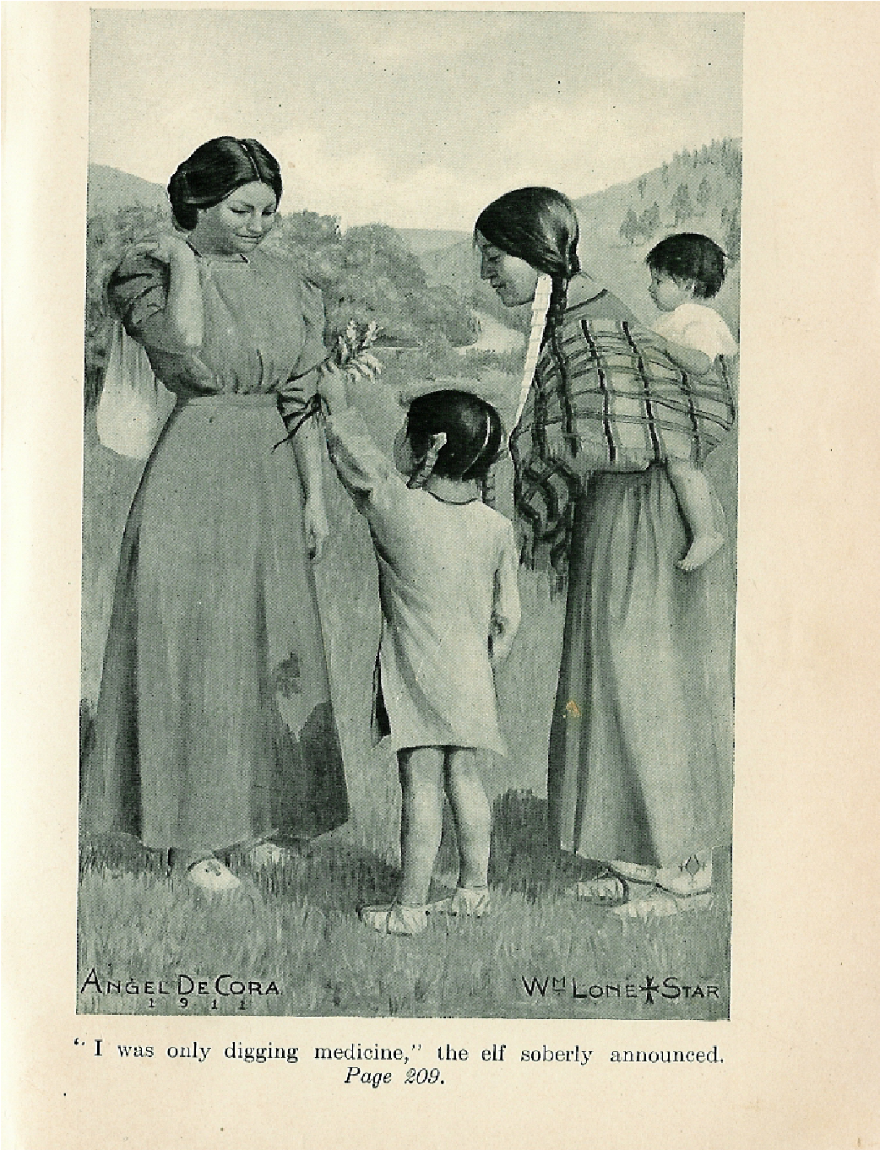
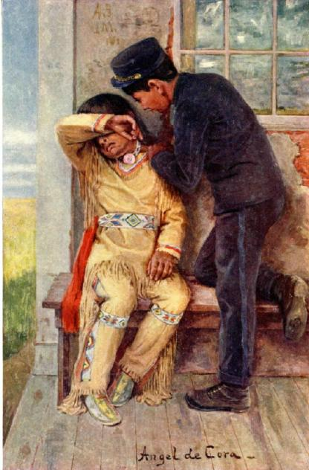
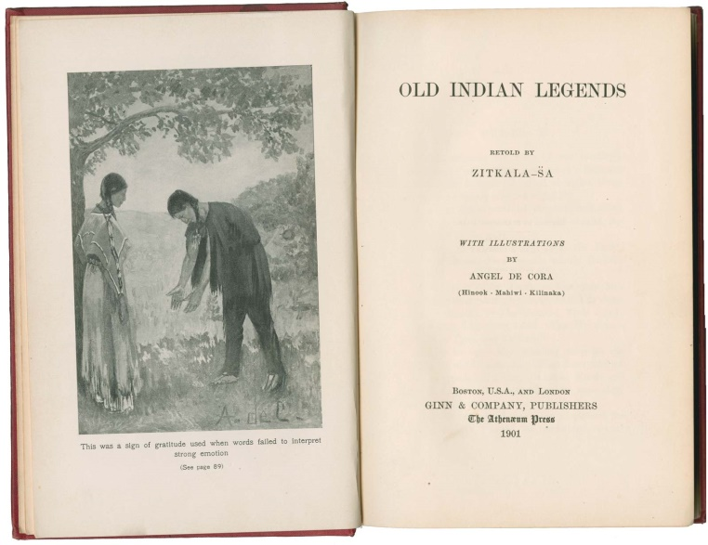
Artist, educator, and advocate
Notes:
Angel DeCora accepted the position at Carlisle on the condition that she would not “be expected to teach in the white man's way, but shall be given complete liberty to develop the art of my own race and to apply this, as far as possible, to various forms of art, industries and crafts.“
The American Arts and Crafts Movement gave DeCora a vehicle to promote the value of Native American art and design. A magazine published at the Carlisle School included designs and illustrations produced and printed by students. Thus she was able to combine artistry and practicality and to use art as a means to economic independence for the students. She showed this ability on one occasion when she left an assignment for her students to complete. On her return she found they had not followed her instructions; instead they had woven covers for the handles of the knives which they were to use. Instead of a punishment she asked them to teach her the stitch which they had invented to accomplish the task.
A frontispiece for The Middle Five shows a student comforting a recent arrival from Omaha to the mission school in Nebraska.
An illustration for the book, Yellow Star: A Story of East and West by Elaine Goodale Eastman, reflects the tension in the relationships to both the Indian and white worlds.
Just as Zitkala-Sa, a Sioux woman writer, tried to “transplant the native spirit of the tales - root and all - into the English language,” DeCora also attempted to “translate Indian customs and life style into and through western European pictorial traditions.”

Slide 30
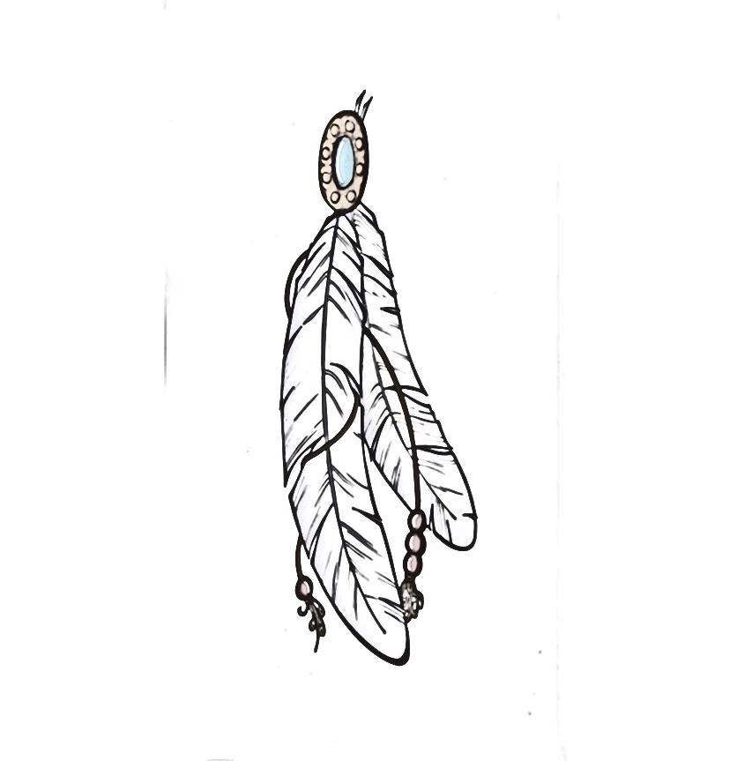
Outstanding in the field of engineering, research, biology, medicine
Notes:
Meet Mary Golda Ross, Floy Agnes Lee, and Isabella Abbott.

Slide 31
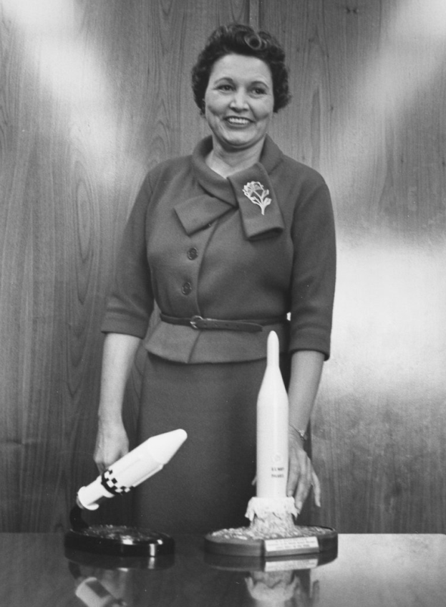


Mary Golda Ross
Cherokee Nation (1908-2008)
Great-great granddaughter of Cherokee Chief
First known Native American female engineer
Worked on a secretive project at Lockheed
Honored in the Native American $1 coin series
Featured in a Google Doodle
Notes:
The Great-great-granddaughter of Cherokee Chief John Ross, Mary Golda Ross graduated from the Cherokee Female Seminary in Tahlequah, Ok. She benefited from the Cherokee’s emphasis on equal education for men and women and from there Mary went on to pursue a career usually open only to men. She said, “It did not bother me to be the only girl in the math class.”
Pursuing a passion for astronomy, she took a master’s degree at the Colorado State College of Education and after earning her degree she joined the Lockheed Aircraft Corporation in 1942. After helping to design the P-38 fighter airplane, she became an integral part of the “space race.”
As one of the 40 engineers in Lockheed’s Advanced Development Programs, known as the Skunk Works, she was the only woman on the team and also the only American Indian.
The 2019 Native American $1 coin features the contributions of Native Americans to the United States space program. These accomplishments include the work of Mary Golda Ross of the Cherokee Nation as well as astronaut John Herrington, Chickasaw Nation. He was the first Native American to walk in space and as part of the 16th Space Shuttle mission he carried the Chickasaw Nation flag to honor his heritage.

Slide 32



She Reached for the Stars
Mary Golda Ross: Ad Astra per Astra
by Cherokee artist America Meredith
“What’s My Line?” - 1958
Notes:
Mary Golda Ross: Ad Astra per Astra by Cherokee artist America Meredith shows Mary Golda Ross against a starry, rocket-filled sky. Ad Astra per Astra means “to the stars from the stars” (a play on the Latin phrase per aspera ad astra) and references a Cherokee origin story of how humans arrived on Earth from the Pleiades. Mary stumped the stars on the panel of “What’s My Line?” TV show in 1958.
During her retirement, Mary worked to recruit young women and Native Americans to engineering careers. At the age of 96, she participated in the opening ceremonies of the Smithsonian’s National Museum of the American Indian on the National Mall in Washington, D.C.
A Google Doodle honored Mary Golda Ross on the 110th anniversary of her birth, Aug. 9, 2018.

Slide 33

Floy Agnes “Aggie” Lee
Santa Clara Pueblo (1922-2018)
Her parents taught at an Indian boarding school
Took flying lessons to join the Women’s Air Force
Earned a degree in biology and worked in a research lab
Recruited to work at Los Alamos
and the Manhattan Project
Notes:
Floy Agnes Lee's mother was German-American and her father was a member of the Santa Clara Pueblo. They met while they were teaching at a boarding school in Santa Fe. Although she grew up in the Indian school she was sent to St. Mary’s School and then graduated from Albuquerque High School. In 1945, she graduated from the University of New Mexico with a degree in biology. During her college years, she also learned to fly planes, with the goal of joining the Women's Air Force but the program was suspended.
After graduation the head of the biology department asked her to stay on and do some research for him. Although she looked forward to seeing her white relatives in Indiana after graduation, she accepted the lab job which included recording information on what the Indians ate before the states became united.
Then came the job offer to work at Los Alamos.

Slide 34


From The Manhattan Project to
STEM Education
Notes:
While doing research on plants at the University of New Mexico, her professor got a call from Los Alamos with a request for a biology student or a graduate to work in the hematology laboratory. She was offered the job and took it since she had not lined up a job following graduation.
As a hematologist at Los Alamos, she collected blood from Manhattan Project scientists, including from Louis Slotin and Alvin Graves after the critical accident that exposed Slotin to a fatal amount of radiation. She played tennis, and often won, with Enrico Fermi and interacted with other Manhattan Project scientists.
Later she worked at the Chicago Met Lab, and later Argonne National Laboratory and the Jet Propulsion Laboratory. While working and caring for her daughter Patricia as a single mother, she earned her Ph.D. at the University of Chicago. Over the course of her long career, she conducted research on the impact of radiation on chromosomes.
Floy has been honored during Women’s History Month. Her great contributions to science, technology, engineering and mathematics (STEM fields of education) have been recognized by educators who have used her and other women to inspire students to achieve in many fields. A lesson plan for grades 7-12 uses oral interviews, “Voices of the Manhattan Project,” created by the Atomic Heritage Foundation with the objective of learning critical thinking skills in analysis of primary and secondary sources.

Slide 35


Isabella Kauakea Yau Yung Aiona Abbott
Native Hawaiian (1919-2010)
Kauakea = “white rain of Hana”
Learned from her mother about Hawaii’s edible seaweed and native plants
First Native Hawaiian woman to earn a doctorate in science
First woman on the biological sciences faculty at Stanford
Published books in her field and won many awards
Became the world’s leading expert on Hawaiian seaweeds
Notes:
Isabella Abbott’s mother taught her about edible Hawaiian seaweeds and the value and diversity of Hawaii's native plants. She met Don Abbott while both were undergraduates at the University of Hawai’i in 1941. He had come to be a pearl diver not realizing they did not live in warm water. Evidently he found a pearl of a different sort, as they had a long marriage, both working in chosen fields and often hosted students in their home.
After earning her PhD she was hired as a lecturer in biology and taught summer courses in 1960 and published scientific papers. Only in 1972, did her productivity as a researcher and skills as a teacher become so undeniable that she was hired as a full professor in biology.
Over the span of her career she won many awards, including the Darbaker Prize, the Gilbert Morgan Smith Medal from the Academy of Natural Sciences, and recognition by the Botanical Society of America. Abbott was also named a Living Treasure of Hawaii and given the opportunity to name a National Oceanographic and Atmospheric Administration research ship, the Hi’ialakai. Being named a “Living Treasure” of Hawaii, gave her great satisfaction. “That moved me the most,” she says, “because it’s for your contribution to your community.”

Slide 36




“First Lady of Limu”
“Izzie Abbott's seaweed expertise ranged from the scientific to the savory.” Stanford Magazine
Notes:
One of the world’s foremost authorities on limu, or the more than 70 edible varieties of seaweed, her work won Abbott the accolade “First Lady of Limu.” She believed “Limu Kala” was one of the most important seaweeds in Hawai’i. She said, “People eat it, turtles eat it. And kala means ‘to forgive.’ It’s used in purification ceremonies like ho’oponopono (the Hawaiian reconciliation process), or if you’ve been sitting with a dead person, or if you’re going on a dangerous journey.
As a teacher, she provided a very supportive, almost nurturing, environment for students. According to a student, "She always had time to listen, had good advice, professional career advice.“
Abbott's culinary accomplishments with seaweed were also renowned and recognized in a 1987 article in Gourmet. She frequently brought dishes that used various seaweeds as an ingredient to potlucks and picnics at Hopkins Marine Station. There was no line between her professional career and her hobbies. Instead of zucchini bread she would show up with a nereocystis cake and no one could tell it wasn’t zucchini. There would never be leftovers.
This is a woman who followed her passion and, in the process, made progress for women everywhere.

Slide 37


Outstanding women
In the arts
Notes:
Meet Buffy Sainte-Marie and Maria Tallchief

Slide 38


Buffy Sainte-Marie
Cree (1941- )
First performer to record electronic vocals in an album
First Indigenous person to win an Oscar
First woman to breastfeed on television
Was blacklisted for her anti-war song, “Universal Soldier”
Notes:
Buffy Sainte-Marie was born on the Cree Reservation in Canada but shortly after her birth, she became an orphan and was adopted by the Sainte-Marie family and was raised in Massachusetts. The Cree singer-songwriter made her debut in 1964 as a trailblazer and a tireless advocate, an innovative artist, and a disruptor of the status quo.
She has devoted her life artistic creative efforts. Her humanitarian efforts and Indigenous leadership have made her a unique force in the music industry. In 1969 she made one of the world’s first electronic vocal albums; in 1982 she became the only Indigenous person to win an Oscar.
She spent 5 years on Sesame Street where she became the first woman to breastfeed her son on national television. When she was approached by Sesame Street to do counting, she demurred but asked about doing a Native American theme and they agreed. When her child Cody was born, the breastfeeding naturally fit into the programming.

Slide 39


“A potent voice and creative force”
Notes:
During her career she has made 18 albums of her music, three television specials, spent five years on “Sesame Street,” scored movies, helped found Canada's Music of Aboriginal Canada Juno Award’s category, raised a son, earned a Ph.D. in Fine Arts, taught Digital Music as adjunct professor at several colleges, and won both a Golden Globe and an Academy Award Oscar for the song, “Up Where We Belong.”
There is still work to be done, and at 79, she’s getting ready for a tour to promote her 20th album, “Medicine Songs.” Buffy doesn’t sugarcoat the truth or shy away from harsh realities. She says she doesn’t write her protest songs to make anyone feel sad or mad but rather to make us feel stronger and more capable of seeing the world around us more clearly.
Described as "a collection of front-line songs of unity and resistance,“ Medicine Songs was released November 10, 2017, by True North Records. According to one reviewer, the new album is a mix of new material and of old classics, woven together as songs about unity and resistance and looking, as the title suggests, to bring some healing to today’s troubled world.

Slide 40


Maria Tall Chief
Osage (1925 – 2013)
First American ballerina to dance with European dance companies
First American Indian Prima Ballerina
Revolutionized ballet with her passionate dancing
Named “Woman of the Year by President Eisenhower
Notes:
Almost from birth, Maria Tallchief was involved in dance, starting formal lessons at age three. When she was eight, her family relocated from her birth home in Oklahoma to Los Angeles to advance the careers of her and her younger sister, Marjorie. At age 17 she moved to New York City, took the name Maria Tallchief and spent five years with Ballet Russe de Monte Carlo where she met legendary choreographer George Balanchine. She became Balanchine’s first star with the New York City Ballet.
With Balanchine’s difficult choreography, her passionate dancing revolutionized the ballet, and her role in The Firebird in 1949 catapulted her to the top of the ballet world, establishing her as a prima ballerina. Her role as the Sugarplum Fairy in The Nutcracker transformed the ballet from obscure to America’s most popular.
She danced with Moscow’s Bolshoi Theater, made regular appearances on American TV before she retired. After retiring from dance, Tallchief was active in promoting ballet in Chicago, directed ballet for the Lyric Opera of Chicago and debuted in the Chicago City Ballet in 1981.

Slide 41


“Woman of the Year”
Notes:
Tall Chief was honored by the people of Oklahoma with multiple statues and an honorific day. She was inducted in the National Women’s Hall of Fame and received a National Medal of Arts. In 1996, Tallchief received a Kennedy Center Honor for lifetime achievements. Her life has been the subject of multiple documentaries and biographies.
She was named “Woman of the Year” in 1953 by President Eisenhower and was featured on the cover of Newsweek, October 11, 1954.
Never forgetting her Native American ancestry, she spoke out against injustices and discrimination. As prima ballerina, Tallchief not only broke barriers for Native Americans, she also became one of the only Americans recognized in European ballet companies.
Throughout her career, Tallchief remained closely identified with her Osage heritage. In 1953, her success was celebrated by the Osage Tribe Nation, who gave her the title “Princess Wa-Txthe-thonba” meaning “the Woman of Two Standards.” Tallchief died on April 11, 2013.

Slide 42

Outstanding women in leadership roles and government
Notes:
Meet U. S. Rep. Deb Haaland, U. S. Rep. Sharice Davids, and Ada Deer.

Slide 43



U. S. Rep. Debra Haaland
Laguna Pueblo (1960- )
Elected to the Laguna Development Corporation Board of Directors
Ran a business producing and canning Pueblo Salsa
Former President of the Democratic Party in New Mexico
Joined the protest at Standing Rock
One of the first Native American Women elected to the U. S. House of Representatives
Notes:
Congresswoman Haaland grew up in a military family and knows the sacrifices made by military families. Though hard work and determination, she earned degrees from the University of New Mexico and UNM Law School.
After starting her own small business, producing and canning Pueblo Salsa, Haaland became the first Chairwoman elected to the Laguna Development Corporation Board of Directors, overseeing business operations of the second largest tribal gaming enterprise in New Mexico. She successfully advocated for the Laguna Development Corporation to create policies and commitments to earth-friendly business practices and administered a local service provider for adults with developmental disabilities.
Haaland became the first Native American woman to be elected to lead a State Party. She used her experience reaching out to communities who are often forgotten during the electoral process during the two Obama presidential campaigns.

Slide 44


“Standing with Standing Rock”
Notes:
During her time as State Party Chair, she traveled to Standing Rock to stand side-by-side with the community to protect tribal sovereignty and advocate for vital natural resources.
“Tribal consultation is the cornerstone of building trust and honoring our government-to-government relationship,” said Debra Haaland, Chairwoman of the Democratic Party of New Mexico. “It’s imperative that our tribes have a seat at the table, and that their voice is respected. The resolution to this issue must be found peacefully to protect the cultural and natural resources of the Standing Rock Sioux tribe.”
After a lifetime of organizing communities to stand up for New Mexico families, Debra Haaland was elected as one of the first Native American women to serve in Congress.

Slide 45


Rep. Sharice L. Davids
Ho-Chunk Nation of Wisconsin (1980- )
One of the first Native American women to be elected to the U. S. Congress.
White House Fellow under President Barrack Obama.
Former Professional Martial Arts competitor
Notes:
Raised by a single mother who served in the Army for 20 years, Representative Davids attended a series of schools and graduated from the University of Missouri-Kansas City with a bachelor’s degree in business administration in 2007.
She began competing in Mixed Martial Arts (MMA) as an amateur in 2006, and went professional in 2013. After competing both as an amateur and a professional, she tried out for The Ultimate Fighter but did not make it onto the show. That led her to shift her focus away from MMA to travel the U.S. and live on Native American reservations to work with the communities on economic and community development programs.
Davids earned her Juris Doctor from Cornell Law School in 2010.

Slide 46



From Martial Arts to Politics
Notes:
As a first generation college student who worked the entire time she was in college, Rep. Davids understands the importance of quality public schools and affordable higher education. It is that foundation that allowed her to go on to a successful career, focused on economic and community development, which included time as a White House Fellow under President Barack Obama.
When she was sworn into the 116th Congress, Rep. Davids became one of the first two Native American women to serve in Congress. Rep. Davids has centered her work in office on putting Kansans first, fighting to limit the influence of special interests and make health care more affordable and accessible to everyone.
Freshman Reps. Deb Haaland and Sharice Davids were featured in a “Jeopardy” clue for making history as the first Native American congresswomen. The game show category was “U. S. representatives” and the clue was “Deb Haaland of the Laguna Pueblo and Sharice Davids of the Ho-Chunk Nation are the first women of this group in Congress.” Contestant Laura Thomason gave the correct answer: Native American.

Slide 47


Ada Deer
Menominee (1935- )
First Native American to earn a M. S. W. at Columbia University
First woman named the Assistant Secretary of the Interior
Head of the Bureau of Indian Affairs.
Led the battle against Tribal termination.
Worked on initiatives of the Clinton Administration
Notes:
Deer was born on the Menominee Indian Reservation in northeastern Wisconsin and lived the first 18 years of her life in a log cabin near the Wolf River with no running water or electricity. She never felt poor and thought of her mother as a great influence on her life, instilling in her rich values which shaped her lifetime commitment to service.
Her life of service began with a solid education, and after graduating in the top ten of her high school class she attended the University of Wisconsin-Madison on a Tribal scholarship. She went on to become the first Native American to receive a M. S. W. from Columbia University.
After graduation, she held several professional positions, including work with the Bureau of Indian Affairs in Minnesota. She studied law for a time and then turned to work on an urgent tribal matter that was to become her major focus over the next several years.

Slide 48



“One person can make a difference”
Notes:
Ada worked tirelessly to help gather together tribal leaders to regain control of Tribal interests and to attempt to reverse termination. She and many others created a new political organization known as Determination of Rights and Unity for Menominee Shareholders (DRUMS). With assistance from the Native American Rights Fund and local legal aid organizations, they fought to regain federal recognition for the Menominees. As a vital part of the restoration effort, in 1972 and 1973 Deer served as vice president and lobbyist in Washington, D.C., for the National Committee to Save the Menominee People and Forest, Inc.
She said, "Mainly I want to show people who say nothing can be done in this society that it just isn't so. You don't have to collapse just because there's federal law in your way. Change it!"
The efforts of Deer and the members of DRUMS resulted in national publicity for the issue of termination and finally the introduction of a bill in Congress to reverse this policy for the Menominees. On December 22, 1973, President Nixon signed the Menominee Restoration Act into law.
Living by her motto, "one person can make a difference" she has received numerous awards over her lifetime. Although she is retired and undergoing cancer treatments, she still is making a difference in her speeches.

Slide 49

Outstanding women faithfully serving in the military
Notes:
Meet Minnie Spotted Wolf and Lori Ann Piestawa.

Slide 50



Pvt. Minnie Spotted Wolf
Blackfeet (1923-1988)
First Native American woman to serve in the USMC
She was an avid outdoors woman
Taught elementary school for 29 years in reservation and small schools
Featured in USMC Public Relations advertising before and during Boot Camp
Notes:
Minnie was a full-blooded Blackfoot Native American and grew up on her parent's small ranch outside Heart Butte, MT. Her chores as a child included cutting fence posts, breaking horses, operating farm equipment and a two-ton truck. When she signed up for the women’s branch of the Marine Corps, their PR department featured her in their recruitment literature. "Calling All Girls" magazine published a four-page comic book-style recounting of Minnie's adventures in Boot Camp and beyond, called "One Little Indian.”

Slide 51




From ranch to Marine Corps
Notes:
In 1943, Minnie Spotted Wolf was the first Native American woman to enlist in the United States Marine Corps Women’s Reserve. Spotted Wolf served for four years in the Marines as a heavy equipment operator as well as a driver.
Upon receiving her Honorable Discharge from the WMCR in 1947, Pvt Spotted Wolf entered Northern Montana College and graduated with a B.A. in Education. In 1952 she married Robert England (taking his last name) and would have four children. She was also known for riding horseback to and from work.
Minnie died in Montana in 1988. She was a devoted member of the Browning American Legion Post# 127 and has a tile of honor in the Montana Veterans’ Memorial.

Slide 52



Lori Ann Piestawa
Hopi (1981 – 2003)
Hopi name Qötsa-Hon-Mana = White Bear Girl
Active in athletics through high school
ROTC Training for 4 years and awarded top female athlete
Joined the military to support her two children
First Native American Woman killed in action on foreign soil
Notes:
Lori was active as a child in sports and pitched for her varsity team during high school. She also did ROTC for 4 years and was awarded top female athlete.
She joined the military to support her two children after her marriage broke up. The Piestawa family had a long military tradition with her grandfather serving in WW II and her father serving a tour of duty in Vietnam.
Lori was a U.S. Army Quartermaster Corps soldier and member of the U.S. Army's 507th Maintenance Company. Following training, Lori was stationed at Fort Bliss in El Paso, where she would meet Jessica Lynch. When President Bush declared war in March 2003, they were deployed to Iraq.

Slide 53




Purple Heart and Prisoner of War Medal
Notes:
In March 2003, Piestawa’s company, US Army’s 507th Maintenance Company, was traveling in a convoy through the desert and took a wrong turn. They got lost and ran into an ambush in Nasiriyah on March 23, 2003, just after the war began. Piestawa dies in the attack, but one survivor,Jessica Lynch, was immediately hailed as a hero.
But the real hero, as Jessica has repeatedly said, was her friend, Lori. Born and raised a Hopi on the Navajo reservation in Arizona, Lorie became the first American woman to die in the war, and the first Native American woman ever to die in combat on foreign soil. Only twenty-three years old, Piestewa saw herself as a Hopi warrior, part of a centuries-old tradition developed by a people who once resisted an invasion and occupation by the U.S. military — much as the Iraqis are doing today. She went to war, but she believed above all in peace, in doing no harm to others.
Her death led to a rare joint prayer gathering between members of the Hopi and Navajo tribes, which have had a centuries-old rivalry.
Piestewa was awarded the Purple Heart and Prisoner of War Medal. The U.S. Army posthumously promoted her from private first class to specialist. The state of Arizona renamed Squaw Peak in the Phoenix Mountains as Piestewa Peak.
And Jessica Lynch named her daughter Dakota Ann in honor of her friend.

Slide 54

Outstanding United
Methodist women
Notes:
Meet Anita Phillips and Anne Marshall.

Slide 55



Anita Phillips
Keetoowah and Cherokee
Ordained an elder in the United Methodist Church
Served as Executive Director of the Native American Comprehensive Plan
Co-authored On This Spirit Walk
Works with Path 1/New Church Starts
Notes:
Reverend Anita Phillips, a member of the Keetoowah Band of the Cherokee Nation, is an elder in the Oklahoma Indian Missionary Conference. She has served as the Executive Director of the Native American Comprehensive Plan (NACP) until stepping down in 2019. NACP is one of six national racial/ethnic plans of the United Methodist Church.
She has previously served several Native American churches in Oklahoma and served as a district superintendent and chair of the Board of Ordained Ministry for her conference. Prior to entering formal ministry, she served as a social worker for over twenty years in the Administration of Cherokee Principal Chief Wilma Mankiller in Native American communities working with families and children. Rev. Phillips has an M.S.W. from the University of Oklahoma, and an M.Div. from Phillips Theological Seminary in Tulsa, Oklahoma.
She has served on many boards and committees at all levels of the UMC and frequently teaches/preaches at annual conference sessions. She co-wrote with Henrietta Mann On This Spirit Walk: The Voices of Native American and Indigenous Peoples.

Slide 56




“On This Spirit Walk”
Notes:
As Executive Director of NACP, Anita has led the denomination in efforts to create awareness about the value of Native Americans in The United Methodist Church; she has worked closely with Conference Committees on Native American Ministries to develop and support Native congregations; and she has also led workshops and training events to empower Native leaders.
In her book, On This Spirit Walk, she invites us to walk with our Native American brothers and sisters, “to see, hear, find Christ” in them. It was the invitation she offered when she spoke at the 2015 Annual Conference.
The Dakota Access Pipeline resistance movement, and the 2016 high-profile, dramatic moments at Standing Rock that were seen in mainstream and social media, have given the opportunity to respond to Phillips’ invitation.
As director of NACP, Anita has partnered with Path 1/New Church Starts of Discipleship Ministries which has commissioned a research study on the “state of Native American ministries and churches” in the U.S. The goals of the first phase of the study were to gain an understanding of the current state of Native ministries and to make informed recommendations on how to strengthen and grow Native American churches, ministries and fellowships in the future.
She is hopeful that the Act of Repentance of 2012 will do that.

Slide 57


Anne Marshall
Muscogee (Creek)
Served on UM Commission on Christian Unity and Interreligious Concerns
Serves as Pension /Benefits Officer of NM Annual Conference
Chaired Native American International Caucus
Currently has a seat on the Muscogee National Council
Notes:
Anna Marshall served on the Commission on Christian Unity and Interreligious Concerns until it was merged into the Bishops Council. She spoke at a meeting in 2000 where concerns were raised about the plans to reduce the membership on governing boards of church wide agencies in the upcoming quadrennium. There were concerns about the lack of visibility of Native Americans in leadership areas of the church. Of special note was that no Native American has been elected bishop. In a rousing speech at the meeting speaking as a member of the Commission on Christian Unity, she spoke of the need to combat racism which is “very open, not subtle.” To her fellow Native Americans she urged, “We need to remind them [non-Natives] that their churches are built on our land.”
At General Conference in 2000 in Cleveland, Anna poignantly reflected on the death of her husband in the 1995 bombing of the Alfred P. Murrah federal office building in Oklahoma City. “It’s been a difficult journey,” she said, “but because of my church community I have not walked alone.
Anna currently serves as the Pension/Benefits Officer of the New Mexico Annual Conference.

Slide 58



Call to Action
Notes:
Anna was part of The Inter-Ethnic Strategy Development Group which made a statement regarding the Call to Action initiative to consolidate the 13 general agencies under a 15 member board. In 2012 they affirmed the “Call for Leadership” but urged “more emphasis on differing dynamics of leadership that will reach a more racially diverse world parish.” She stressed the importance of partnering with other Native American groups and work together to achieve the goals of the “Call to Action.”
Anna Marshall also spoke in 2012 in Tampa, Florida, as Chairperson of the Native American International Caucus. She said that in the Act of Repentance the church should consider repenting not only of past crimes against indigenous people, but also of what is happening today. In response to the continuing LGBTQ ban, she said “It is time to join our brothers and sisters who continue to seek a place in the United Methodist Church and provide that space as we should for all people of God.”
Anna continues to serve her people, the Muscogee Nation. She was elected to a seat on the Muscogee National Council for the 2020-2021 term.

Slide 59

Like Dignity, the statue that honors all Native women as she stands tall in South Dakota, these women stand tall.
May their tenacity, determination, and spirit inspire you to learn more.
EPA CoNAM

Slide 60
Conversation
HIDDEN FIGURES:
OUTSTANDING
NATIVE AMERICAN WOMEN
Notes:
You may be familiar with names like Pocahontas or Sacajawea and with stereotypical, often demeaning, images of Native Americans, but we want to tell you about outstanding women who have “moved mountains” or changed the lives of their people and all of us.
We will introduce you to women in an array of careers and professions in the fields of education, the arts, science, leadership and government, activism and religion.

